Slide 1
Video games popularity and sales analysis a
Group 15
Group members:
Tushar Rao
Yiwei Li

Slide 2
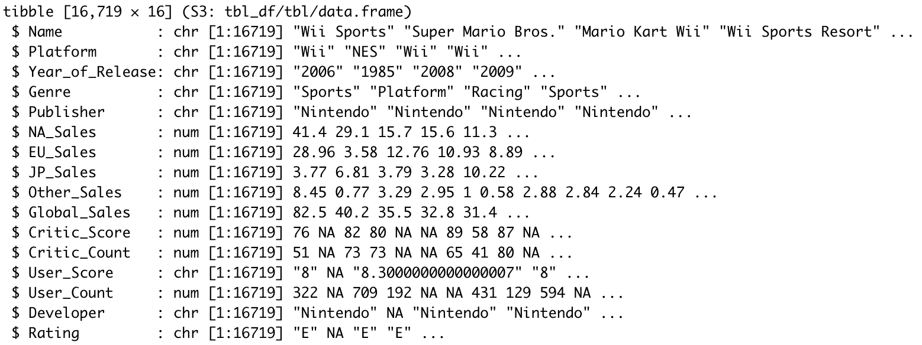
Data exploration
We analyzed the distributions of some attributes to get an idea about the distribution of the data.

Slide 3
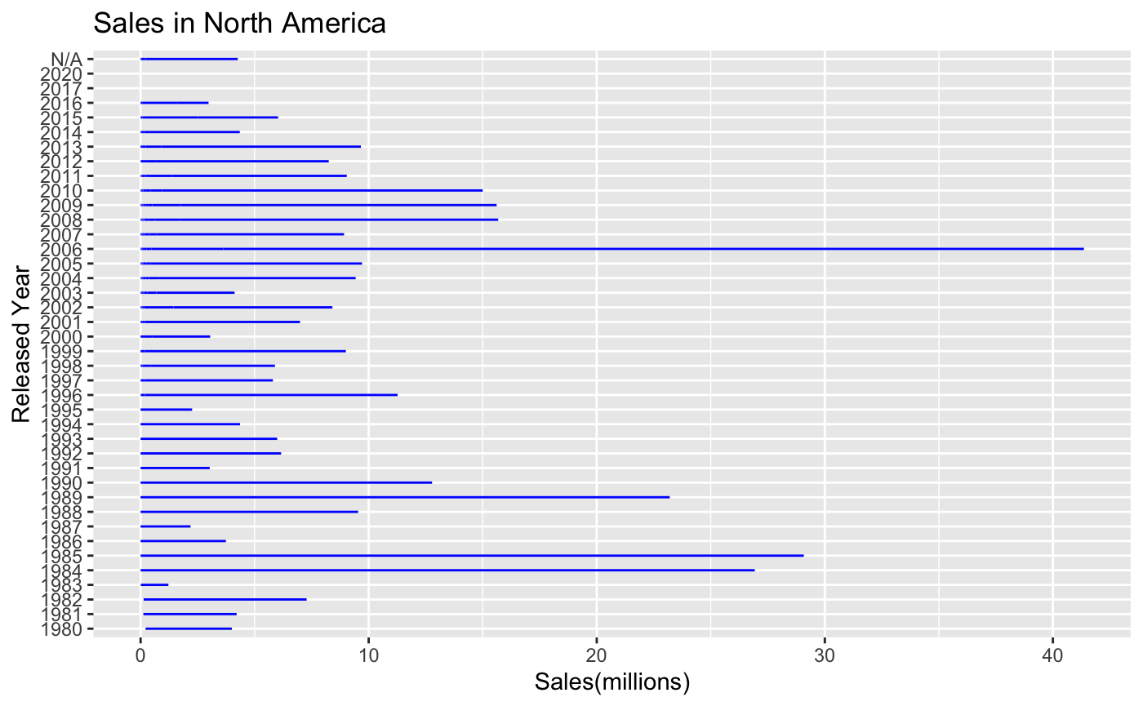
The sales amount reached the highest in 2006 in North America, and the sales amount suffered a relatively low sales amount period between 1991 to 2005.

Slide 4
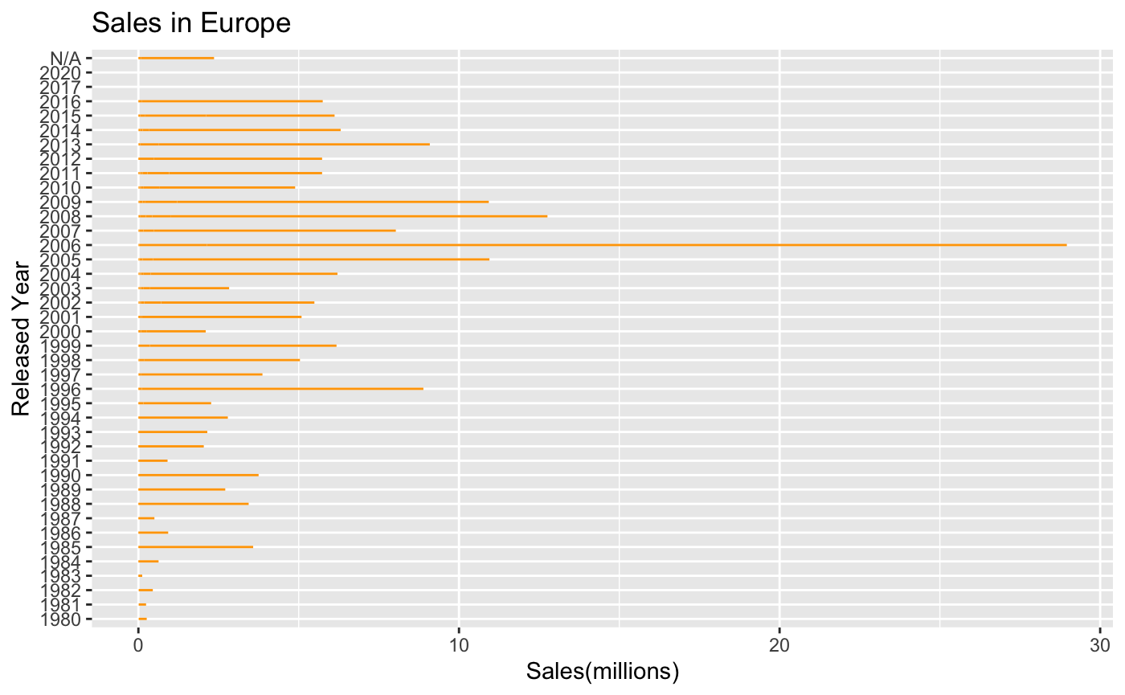
The sales amount also reached the highest in 2006 in Japan, and the sales amount distribution is much lower during 1980 to 2005, and the sales amount between 2007 to 2016 was stable.

Slide 5
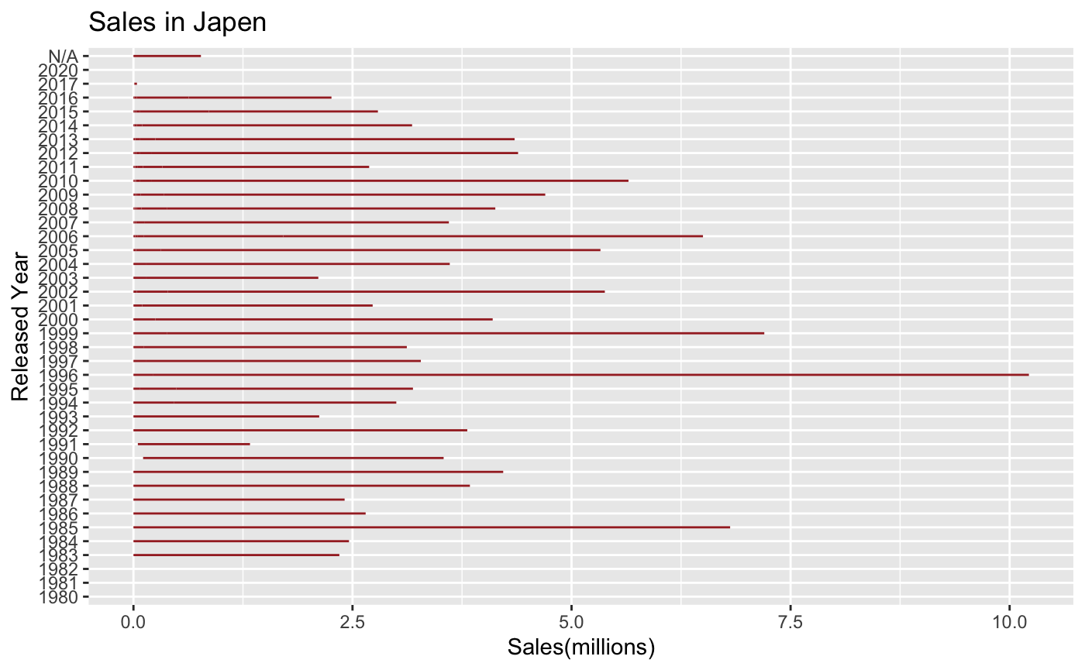
The sales amount reached the highest in 1996 in Japan, and the overall sales amount are relatively high, but it begins to decrease from the recent years.

Slide 6
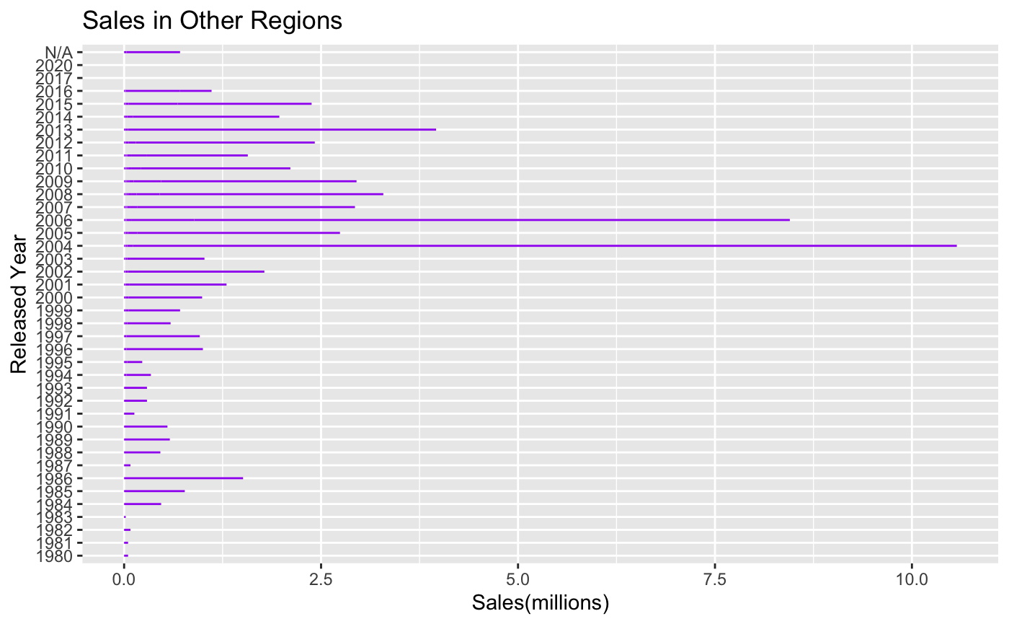
Different from the North America and Europe, the sales amount reached the highest in 2004, but the amount in 2006 is the second highest in 40 years. Compared to North America, Europe and Japan, the sales amount before 2004 was much lower, this may related to the economy develop degree.

Slide 7
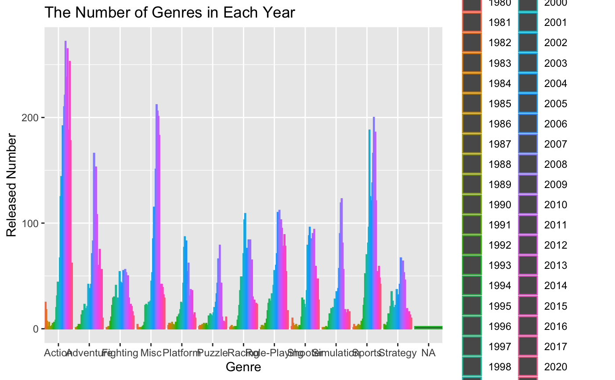
There are 12 kinds of games released in the past 40 years, from the bar chart above we could see that the “Action” might be the most popular genre since it had the most released number especially between 2010 and 2013. However, the “Fighting” one has the lowest value, this may due to some juvenile protection policies in some areas.

Slide 8
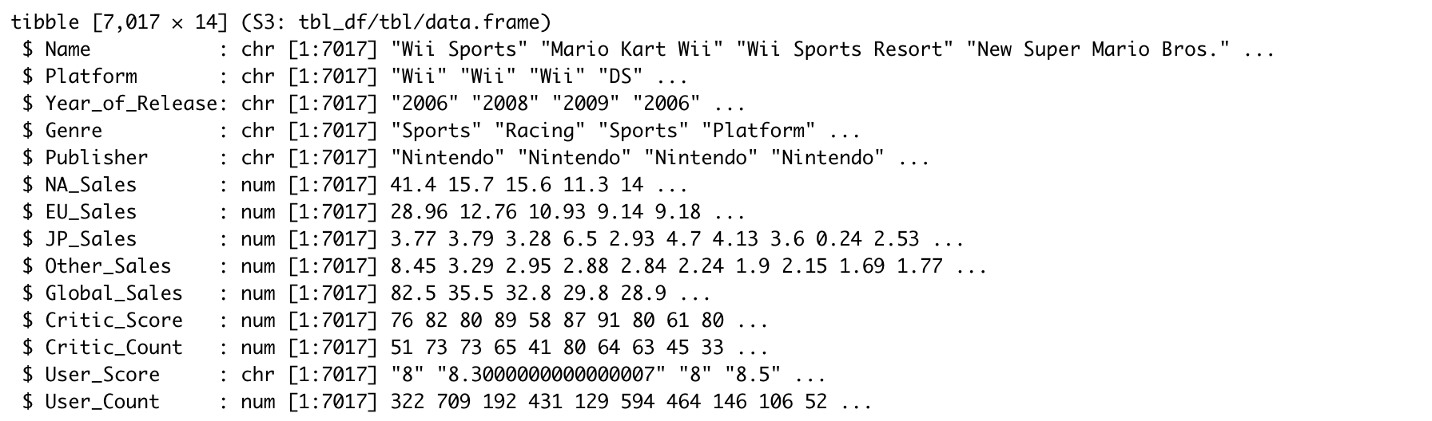
Data Preparation and Preprocessing
We split 0.8 of the data for training and 0.2 for testing after delete the useless columns. And removed the last 2 column developer and rate from the dataset.

Slide 9
Part1: KNN ( k-nearest neighbors algorithm)
Data prepare:Choosing the relative variables: Platform, Genre, Publisher, Critic_Score, User_Score.
Method:Split the data into training data(80%) and validation data(20%). Then normalize them and put the training data into our knn models.
Then Determing the best K

Slide 10
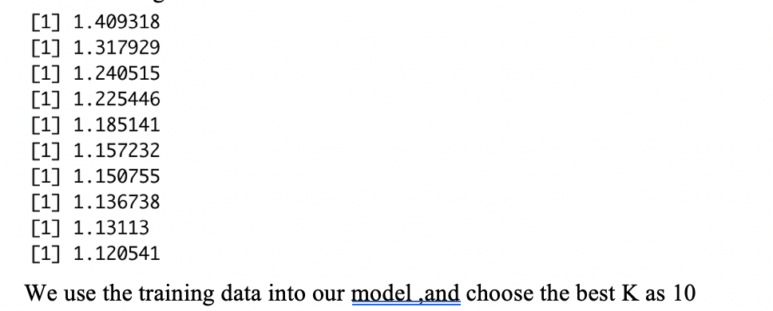
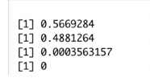
KNN( k-nearest neighbors algorithm)
Model:
Accuracy：
Best K-value
Result

Slide 11

Linear Regression

Slide 12
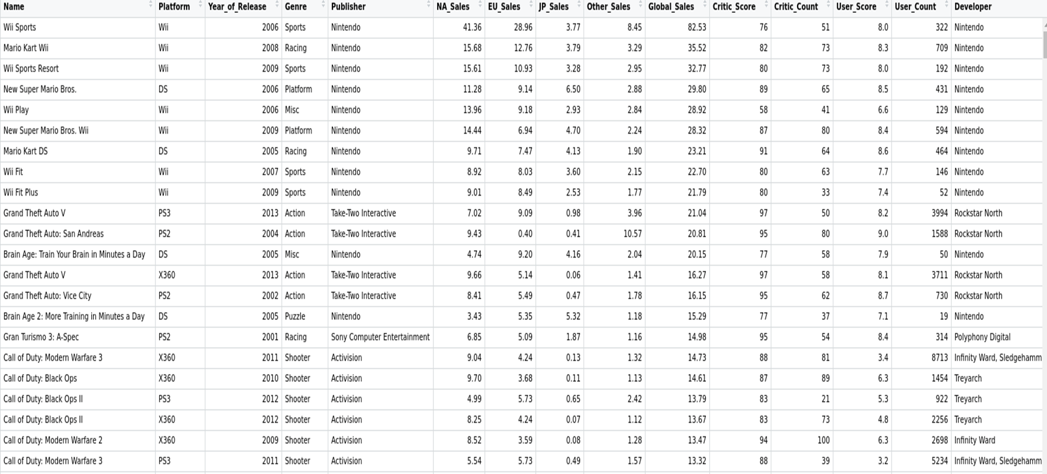
DATA EXPLORATION

Slide 13
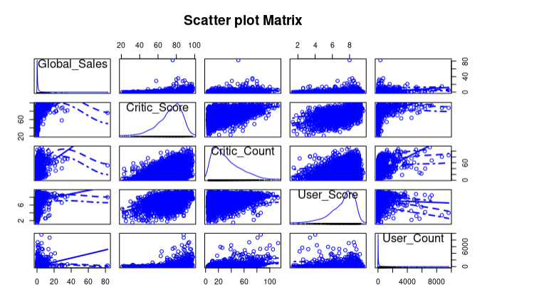
Data Exploration and Feature Selection

Slide 14
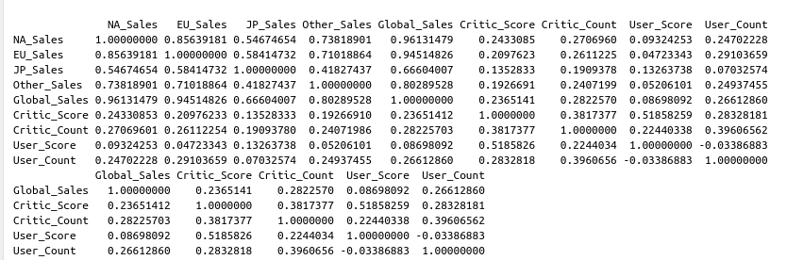
Data Exploration and Feature Selection
Correlation matrices

Slide 15
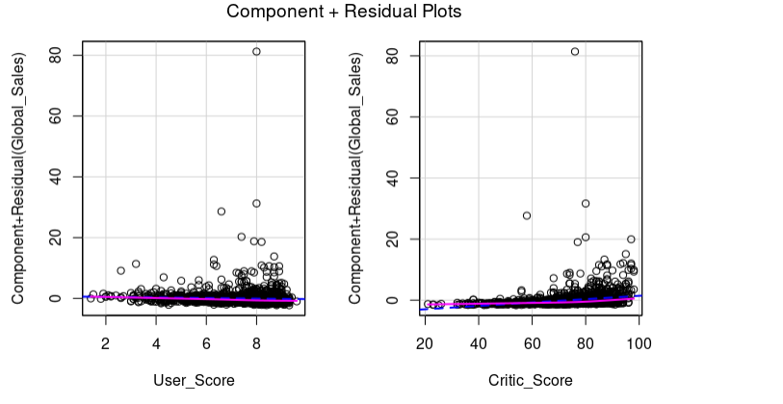
CR Plots

Slide 16
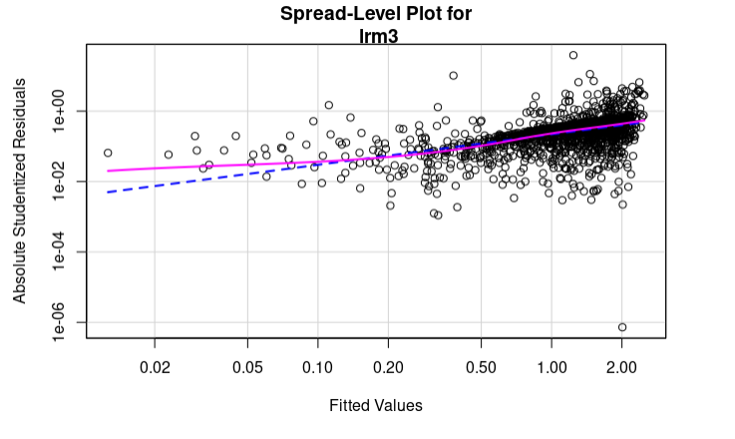
Spread Level Plots

Slide 17
Linear Regression
Anova score
AIC Score

Slide 18
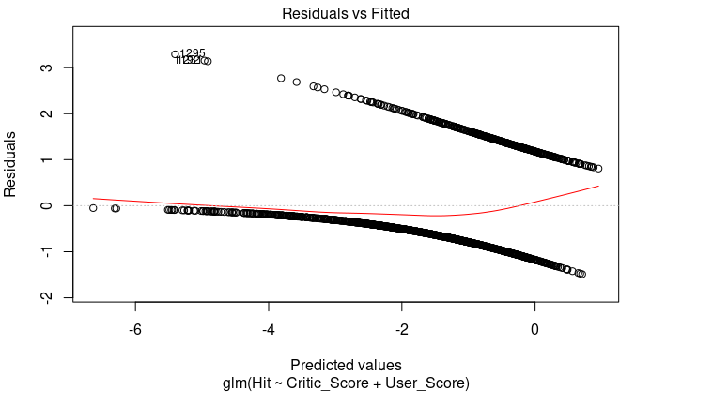
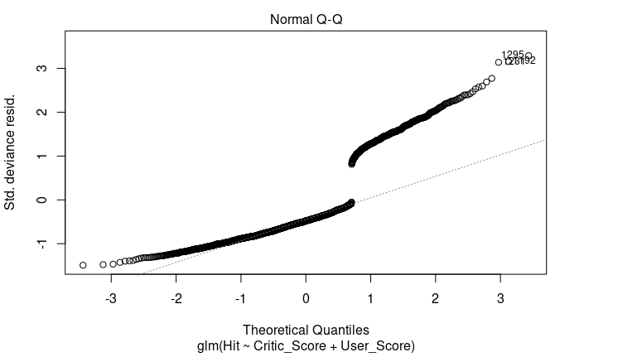
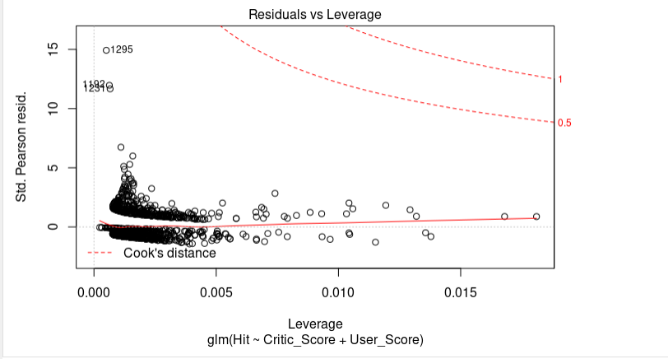
Logistic Regression

